Slide 1
DATA ANALYTICS
TEAM MEMBERS:
G.Shanmukhi Srivalli (20NM1A0224)
K.Visalakshi (20NM1A0239)
G.Sunitha (20NM1A0233)
E.Keerthana Lakshmi (20NM1A0222)

Slide 2
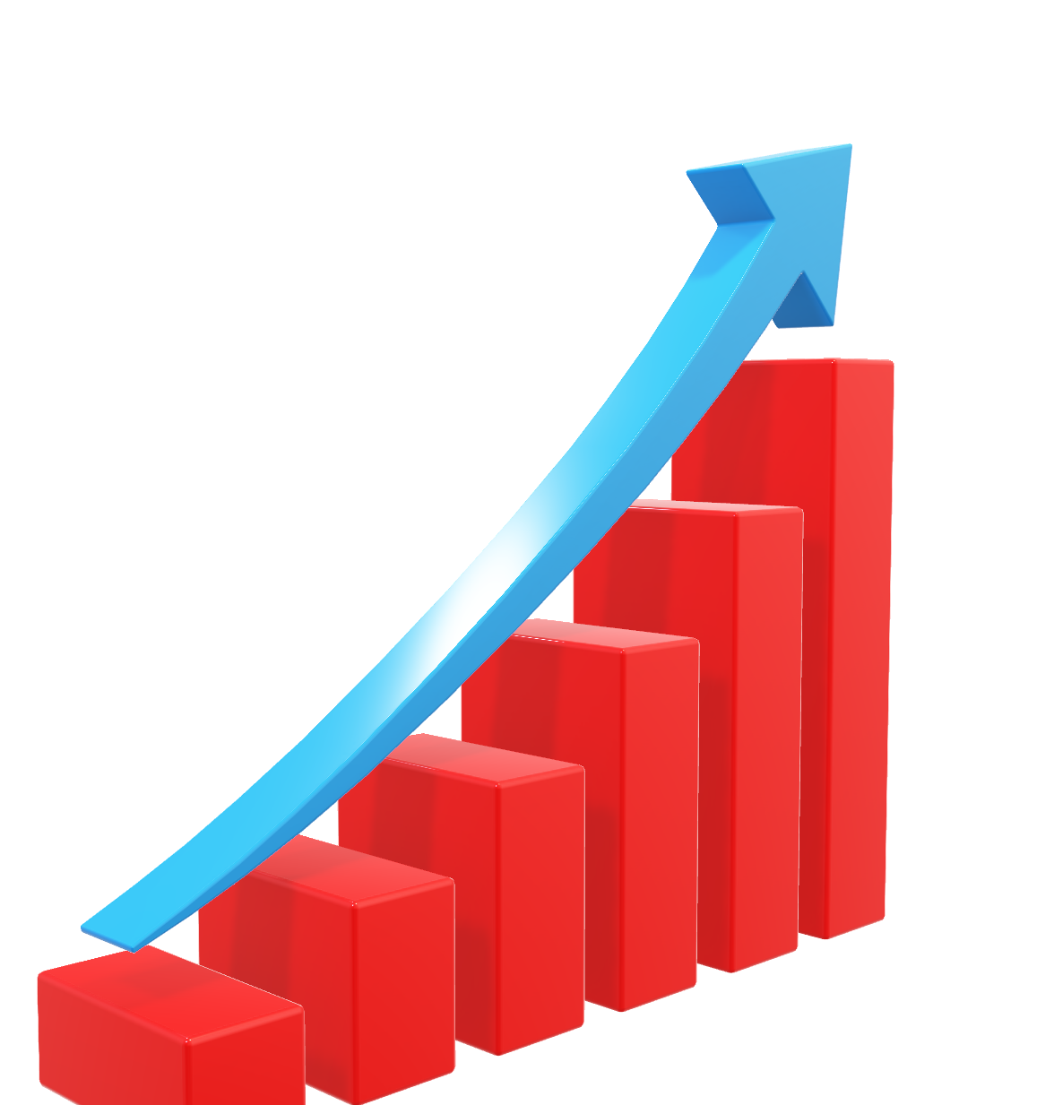
ANALYZING THE PERFORMANCE & EFFICIENCY OF THE RADISSION HOTELS USING DATA VISUALIZATION TECHNIQUES

Slide 3
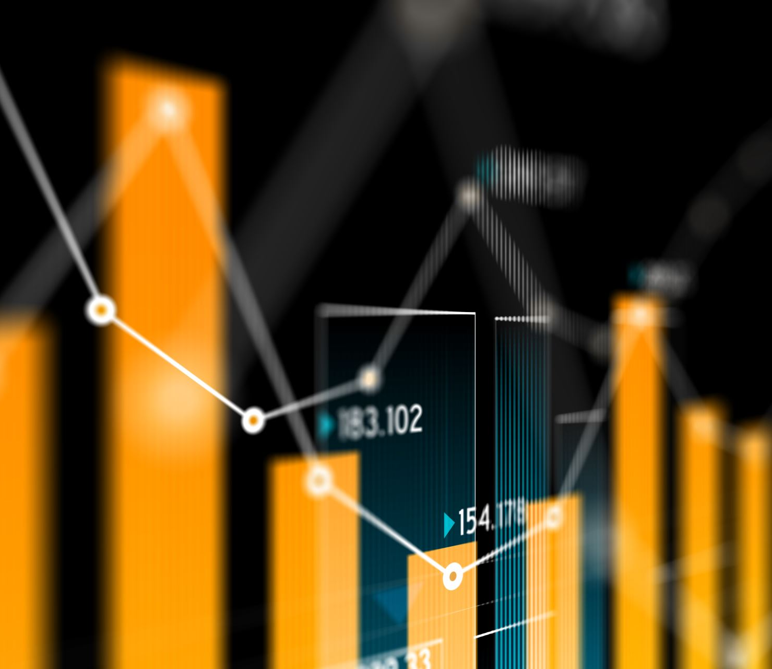
WHAT IS DATA ANALYTICS?
Data analysis helps determine what is and isn't working, so you can make the changes needed to achieve your business goals. Keep in mind that data analysis includes analyzing both quantitative data (profits and sales) and qualitative data (surveys and case studies). Data analytics is the collection, transformation, and organization of data in order to draw conclusions, make predictions, and drive informed decision making.

Slide 4
WHERE?
In general, data analysts are everywhere. You can also find them in almost every industry—large insurance companies, credit bureaus, technology firms, banks, and manufacturers. Tech companies such as Meta and Google analyze big data to a dizzying degree.
HOW?
Enterprises can use data analytics to guide business decisions and minimize financial losses. Predictive analytics can suggest what could happen in response to changes to the business, and prescriptive analytics can indicate how the business should react to these changes.
WHEN?
It utilizes statistical modeling techniques, machine learning algorithms, and time series analysis to identify patterns and build predictive models. It is often used for forecasting sales, predicting customer behavior, or estimating risk.
DATA ANALYTICS

Slide 5

SOCIAL IMPACT
ANALYSIS:
Social impact analysis uses data analysis techniques and tools to measure the impact of a particular initiative, program, or policy on a specific outcome or set of outcomes

Slide 6
Improved Decision Making Foremost among the top data analytics decision-making Increased Efficiency and Productivity Enhanced Customer Experience Improved Risk Management Competitive Advantage
BENEFITS OF
DATA ANALYTICS:

Slide 7

TABLEAU
What?
Tableau is a leading data visualization tool used for data analysis and business intelligence. Gartner's Magic Quadrant classified Tableau as a leader for analytics and business intelligence.
Why?
Following are the reasons that make Tableau necessary and easy to use in data science: On Tableau, you can add data models designed in various scripting languages like R or Python and perform complex calculations. Blend visualizations in the form of dashboards and deliver insights understandably.
How?
Work with Data Fields in the Data Pane. Navigate Data Sources in the Data Pane. Navigate Between the Start Page and Workspace. Apply Advanced Analysis to the View (Analytics Pane) Shelves and Cards (Columns, Rows, Marks, Filters, Pages, Legends) Parts of the View.

Slide 8
What is a database and which database is used in data analytics?
Relational and multi-dimensional databases are the most common databases for Operations Analytics. Relational databases store data in rows and columns and they include Microsoft SQL Server, Oracle, Sybase, DB2, Informix, MySQL, etc.
A database is an organized collection of data, stored and accessed electronically. Databases are used to store and manage large amounts of structured and unstructured data, and they can be used to support a wide range of activities, including data storage, data analysis, and data management

Slide 9
How to collect dataset for data analytics?
7 Data Collection Methods Used in Business Analytics Surveys.
1. Surveys are physical or digital questionnaires that gather both qualitative and quantitative data from subjects.
2.Transactional Tracking.
3.Interviews and Focus Groups.
4.Observation.
5.Online Tracking.
6.Forms.
7.Social Media Monitoring.

Slide 10
How to perform SQL operations in data analytics?
SELECT and FROM form the foundation of all SQL queries. The most basic SQL query will involve these two commands and as the query gets more complex, more commands will be added on top of them. SELECT informs which columns you want to select whereas FROM specifies which table you want to query the data from.

Slide 11
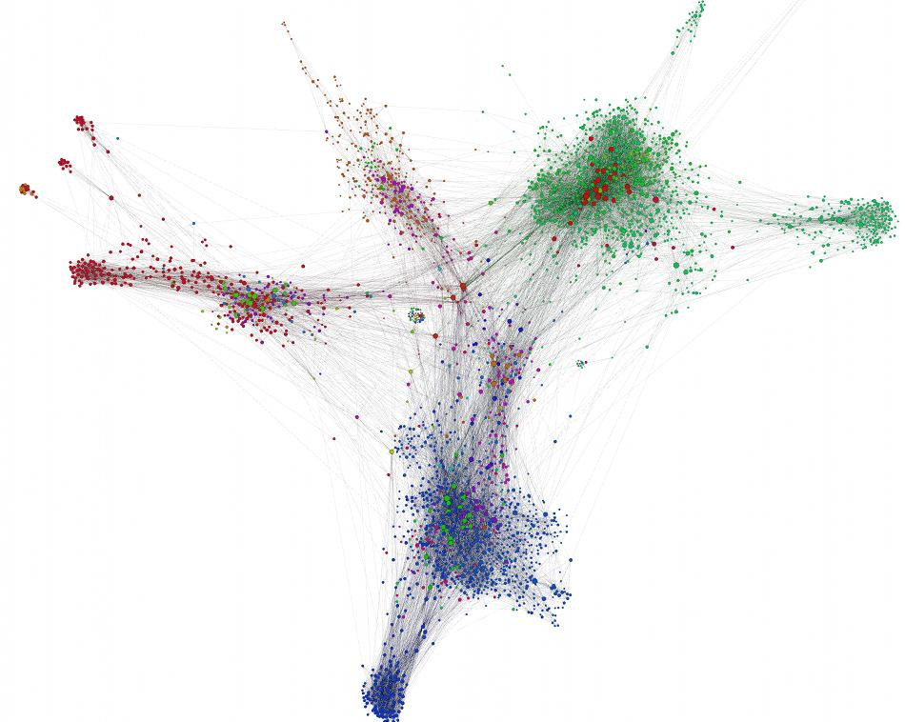
VISUALIZATION
GRAPH VISUALIZATION
Data visualization is the representation of data through use of common graphics, such as charts, plots, infographics, and even animations. These visual displays of information communicate complex data relationships and data-driven insights in a way that is easy to understand.
Graph visualization, also called link analysis or network visualization, is a way to visually represent connections between entities in data. The most effective way to visualize graphs is through a node-link model, where nodes represent entities and links represent connections

Slide 12
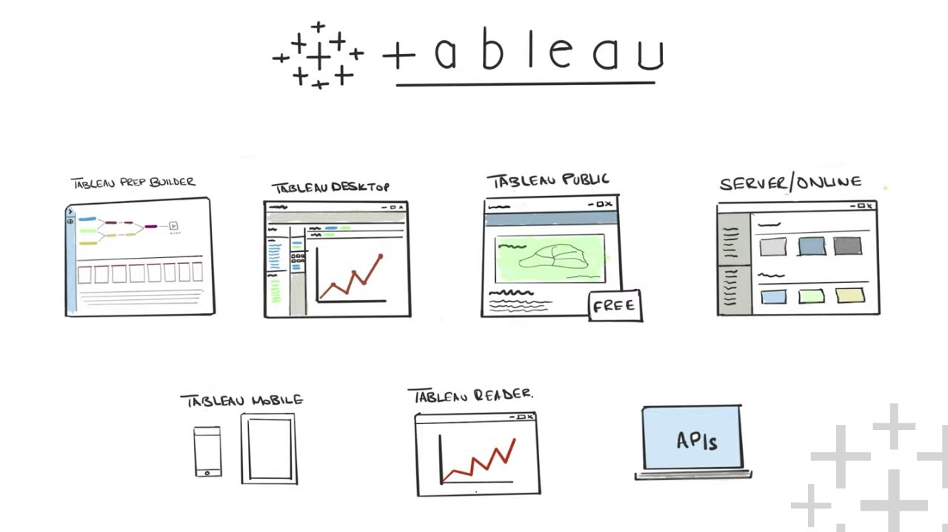
WORKSHEETS:
This Photo by Unknown Author is licensed under CC BY-NC-ND

Slide 13
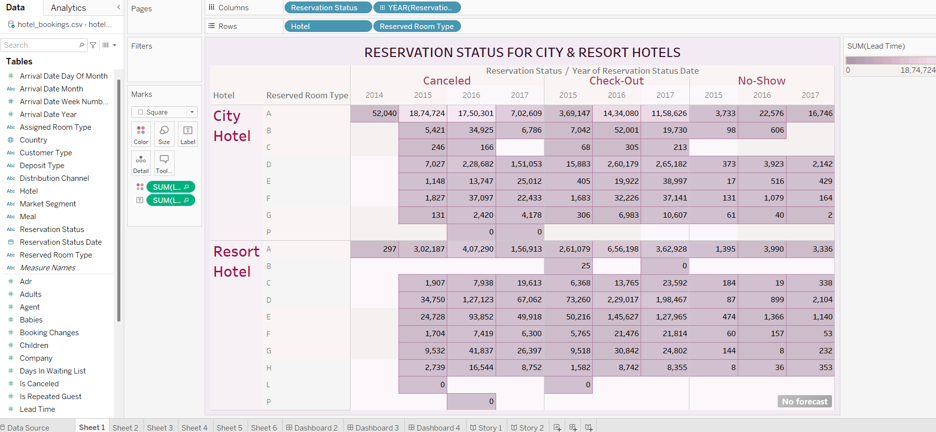

Slide 14
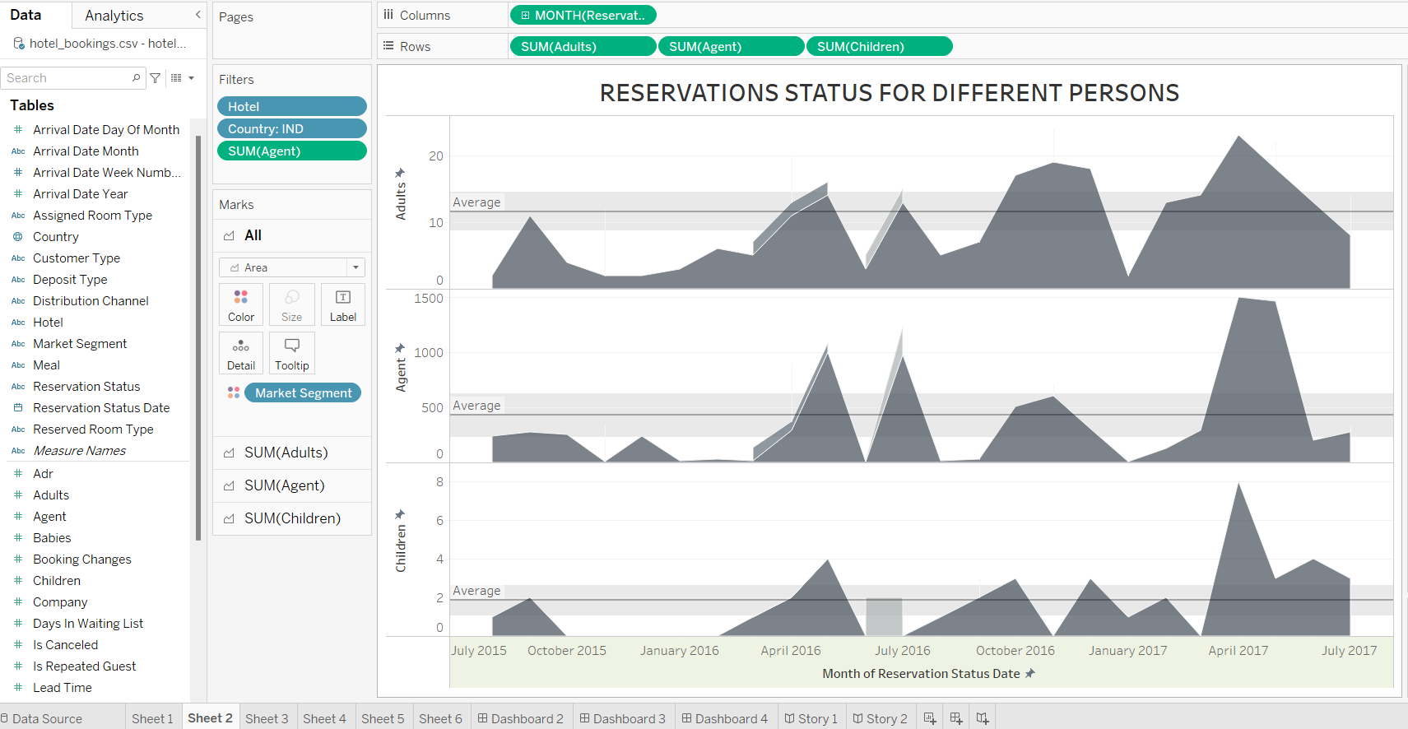

Slide 15
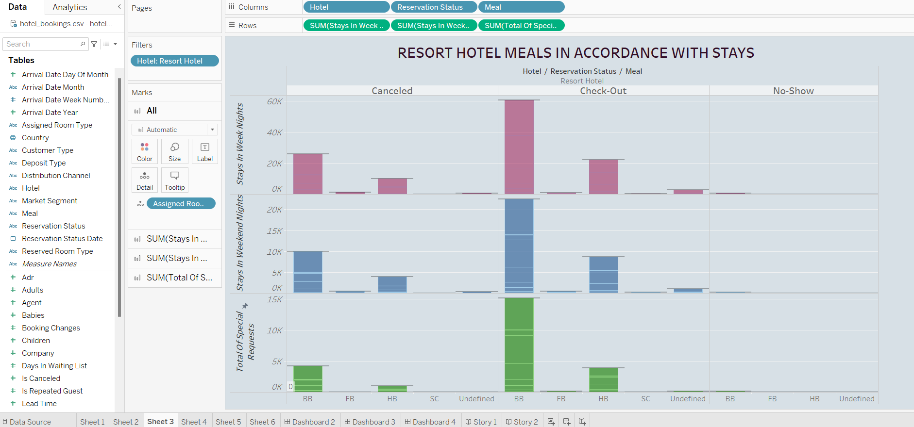

Slide 16
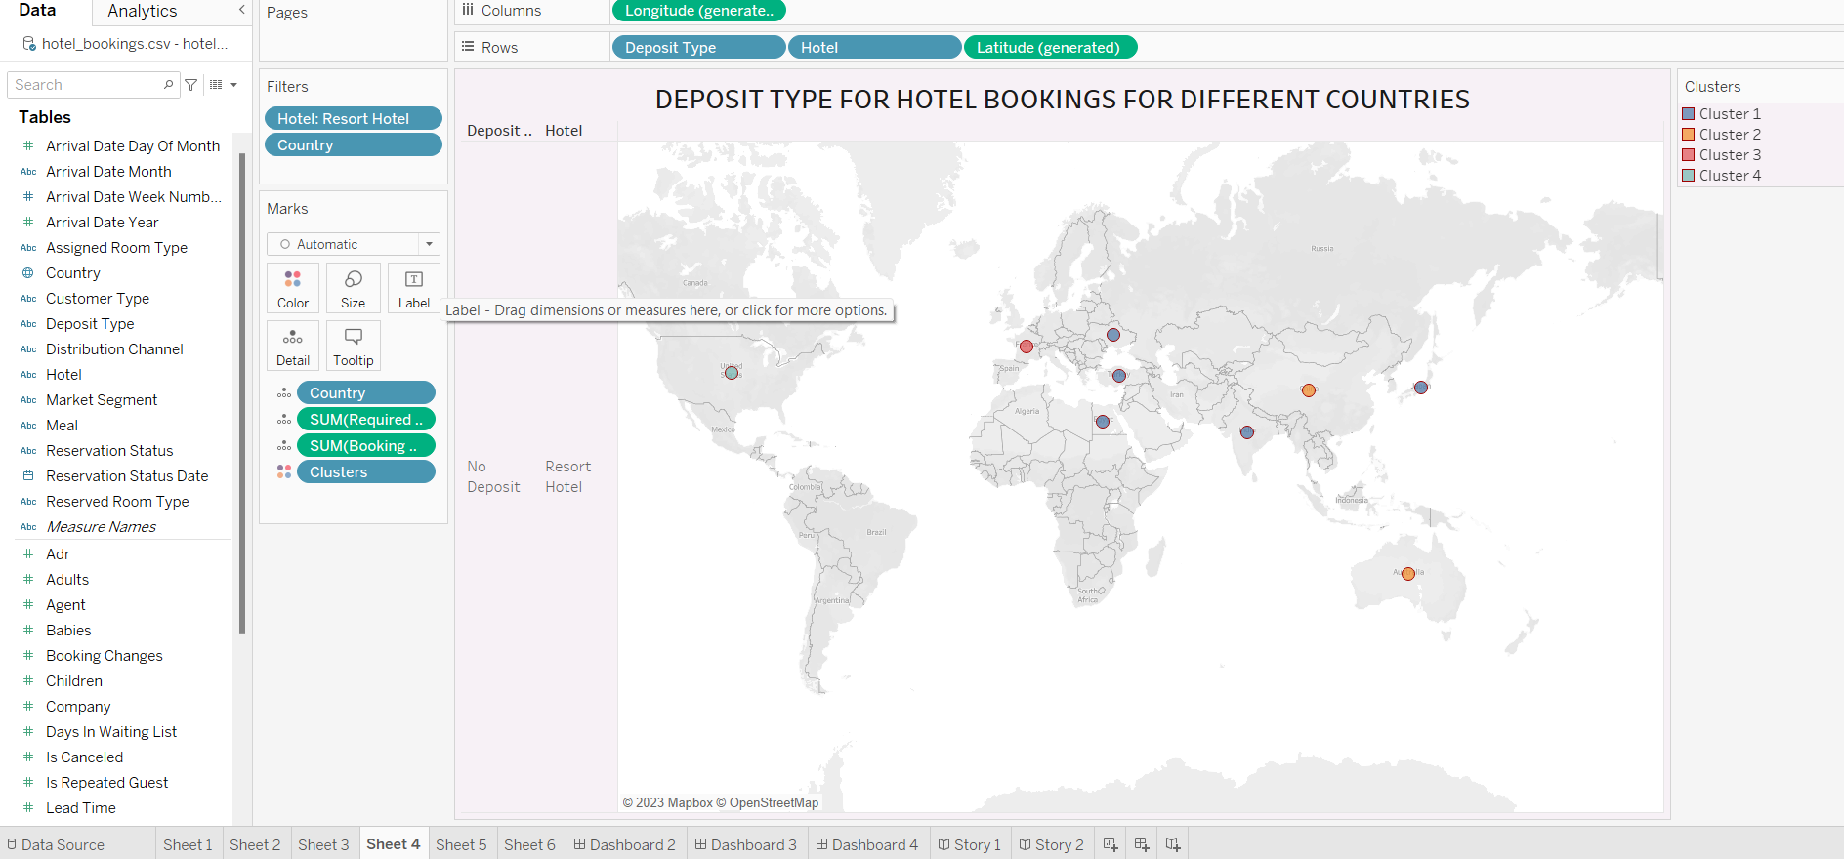

Slide 17
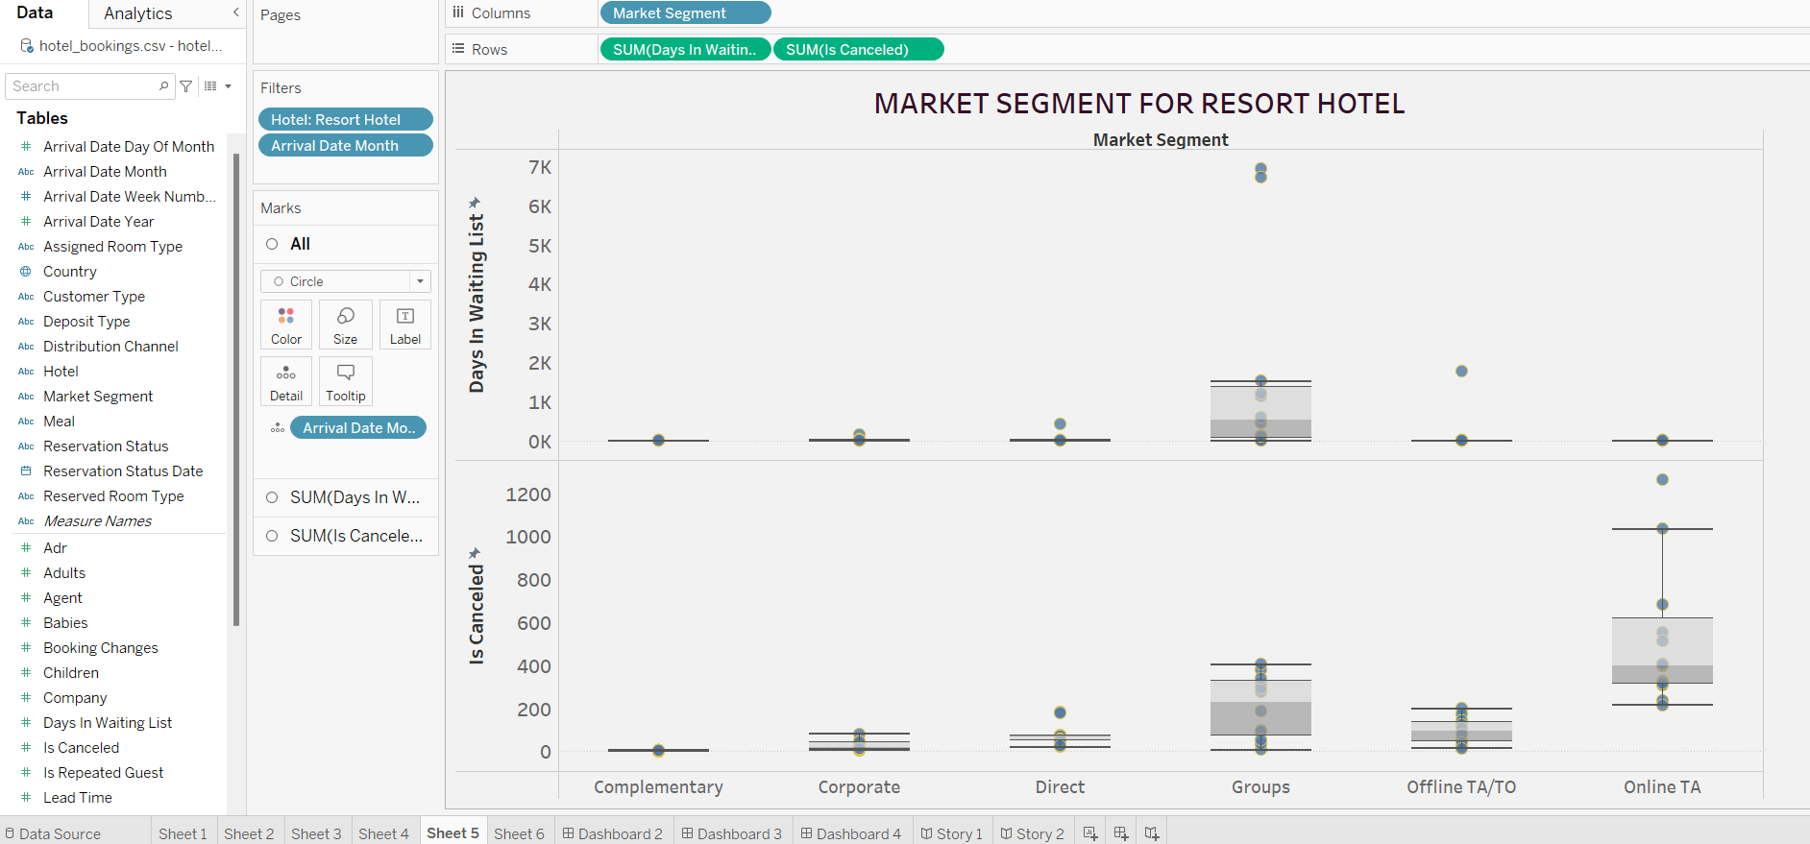

Slide 18
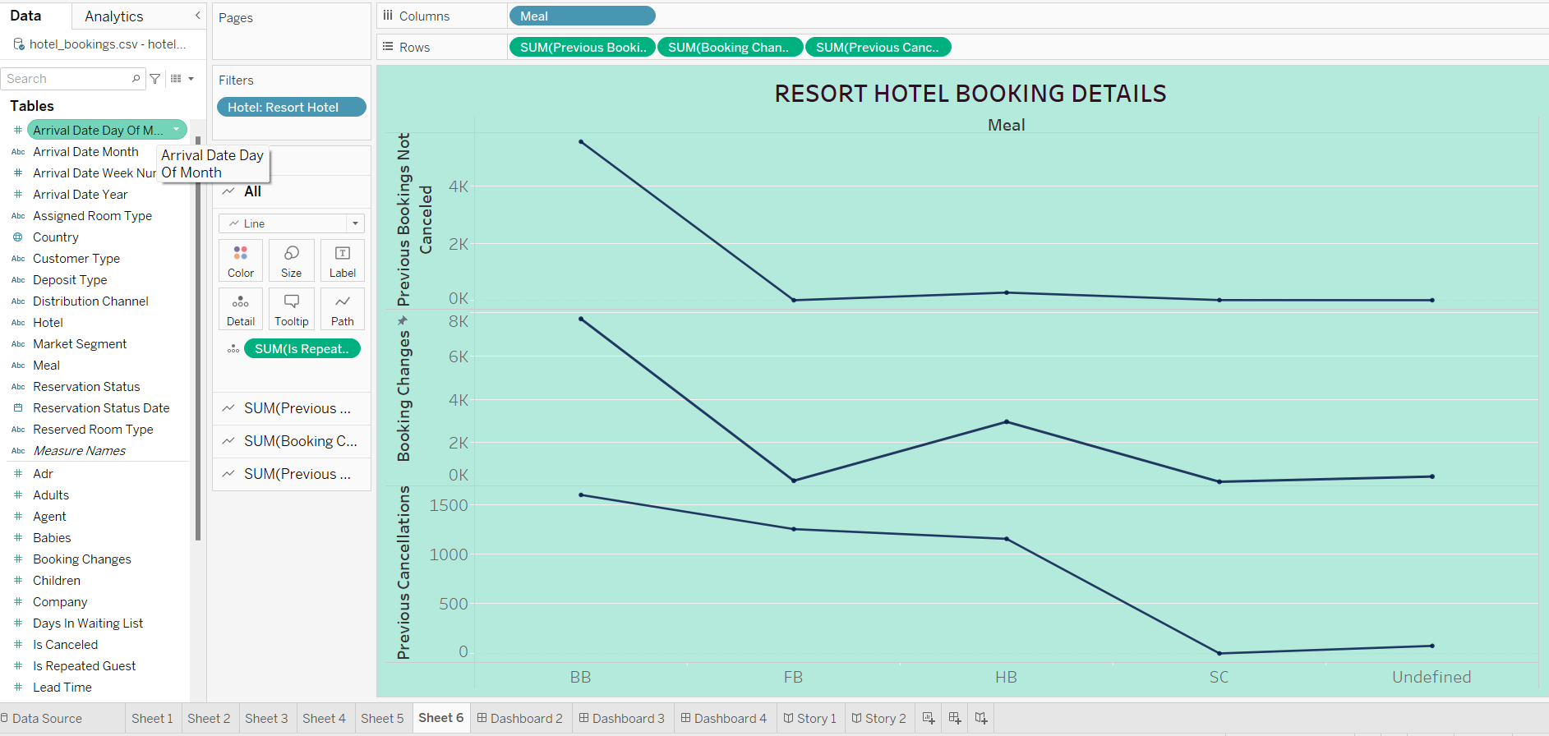

Slide 19
How to Create a Dashboard using Data Analytics ?
1.Sign in to your Google Analytics account.
2.Select your desired view from the provided list.
3.On the left hand side, click on the Customization dropdown.
4.Click 'Dashboards’.
5.Click the read 'Create' button to create a new dashboard.

Slide 20
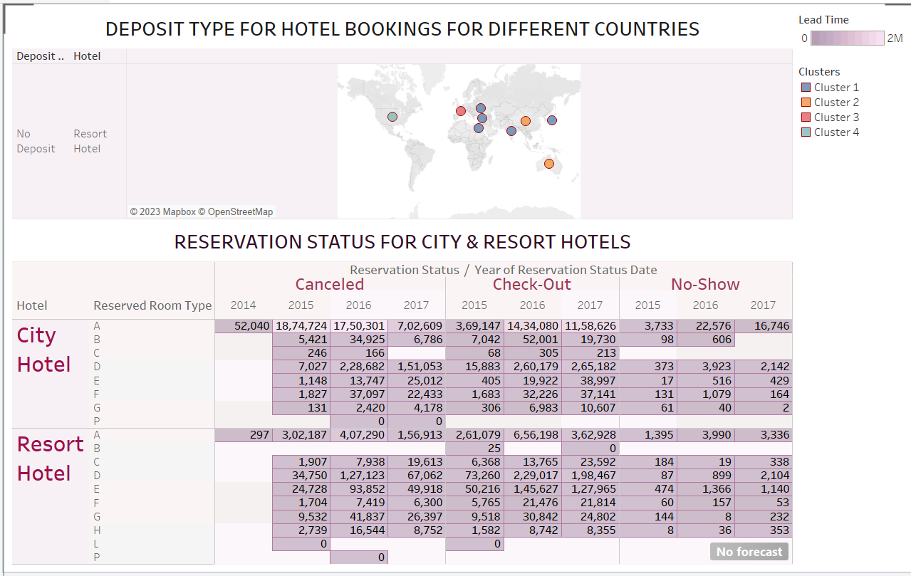
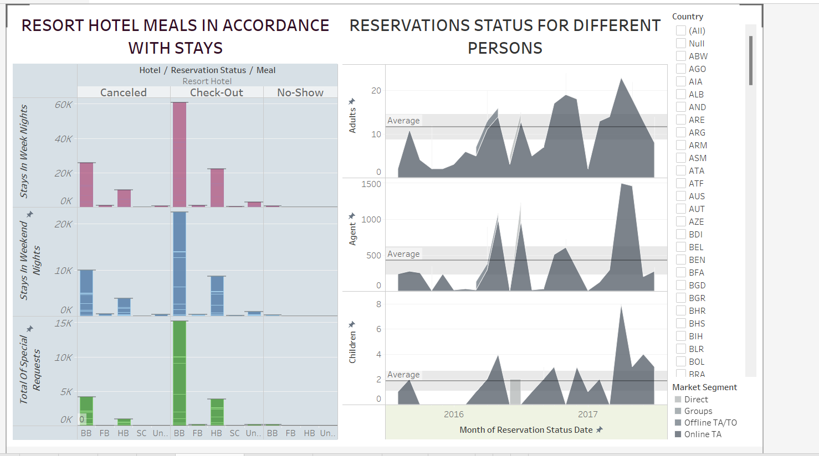
DASHBOARDS:

Slide 21
How to create a story in tableau?
Add a Tableau Data Story to a Dashboard.
Choose the Right Story Type for Your Tableau Data Story.
Configure Settings for a Tableau Data Story.
Customize Your Tableau Data Story.
Add More Data to Your Tableau Data Story.
Add a Pop-Up Tableau Data Story to Your Dashboard.

Slide 22
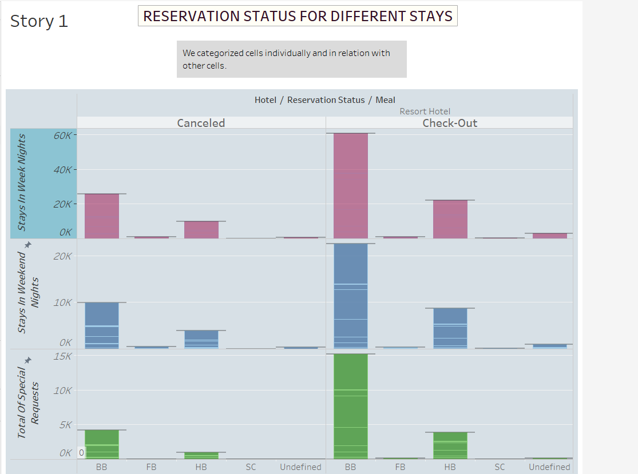
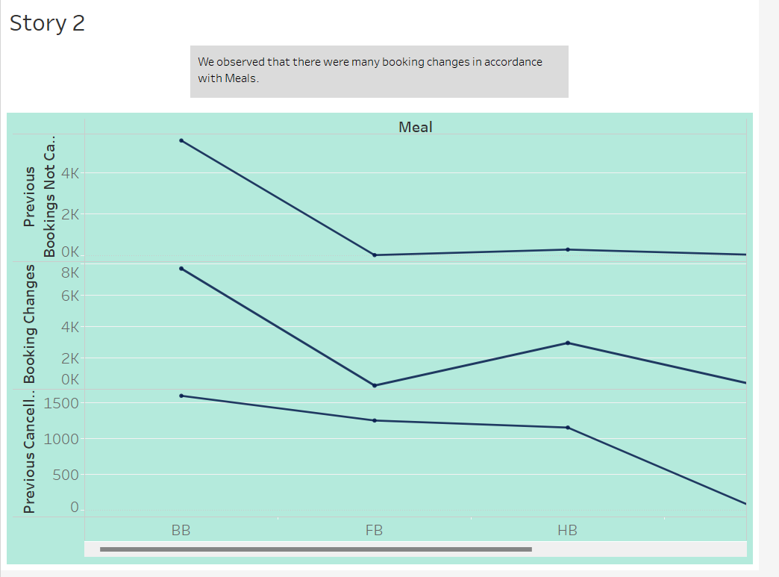
STORIES

